Slide 1
SDN UDP Flood Firewall with Floodlight Controller
Autorzy:
Paweł Bałuszyński, Michał Błaszczyna, Kamil Kawka, Kamil Sobolak

Slide 2
Literatura
DOS Attack Mitigation Strategies on SDN Controller by Yun Tian, Vincent Tran, Mutalifu Kuerban (2019) presented at IEEE 9th Annual Computing and Communication Workshop and Conference (CCWC).
Extending the Floodlight Controller by Laura Victoria Morales, Andres Felipe Murillo, Sandra Julieta Rueda presented at the 2015 IEEE 14th International Symposium on Network Computing and Applications.
SDN Controllers: A Comparative Study by Ola Salman, Imad H. Elhajj, Ayman Kayssi, Ali Chehab, presented at the 2016 18th Mediterranean Electrotechnical Conference (MELECON), published by IEEE.)
Early Detection of Distributed Denial of Service Attack in Era of Software-Defined Network by Bineet Kumar Joshi, Nitin Joshi, Mahesh Chandra Joshi, presented at the 2018 Eleventh International Conference on Contemporary Computing (IC3), published by IEEE.)
Early Detection of DDoS Attacks Against SDN Controllers by Seyed Mohammad Mousavi, Marc St-Hilaire, presented at the 2015 International Conference on Computing, Networking, and Communications (ICNC), published by IEEE.)

Slide 3
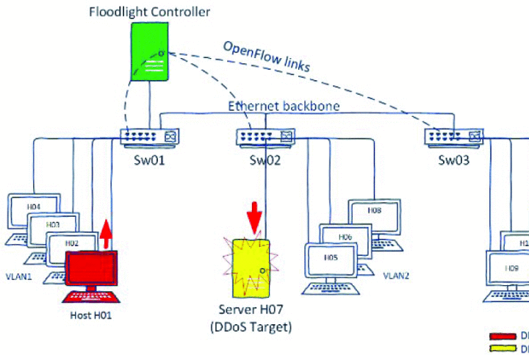
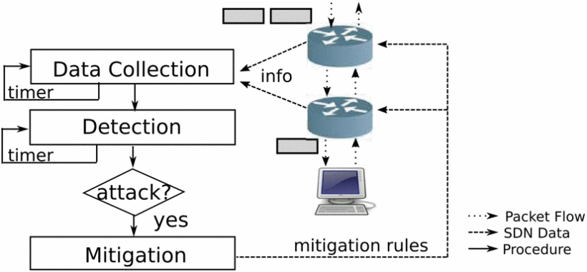
Podobieństwo do literatury

Slide 4
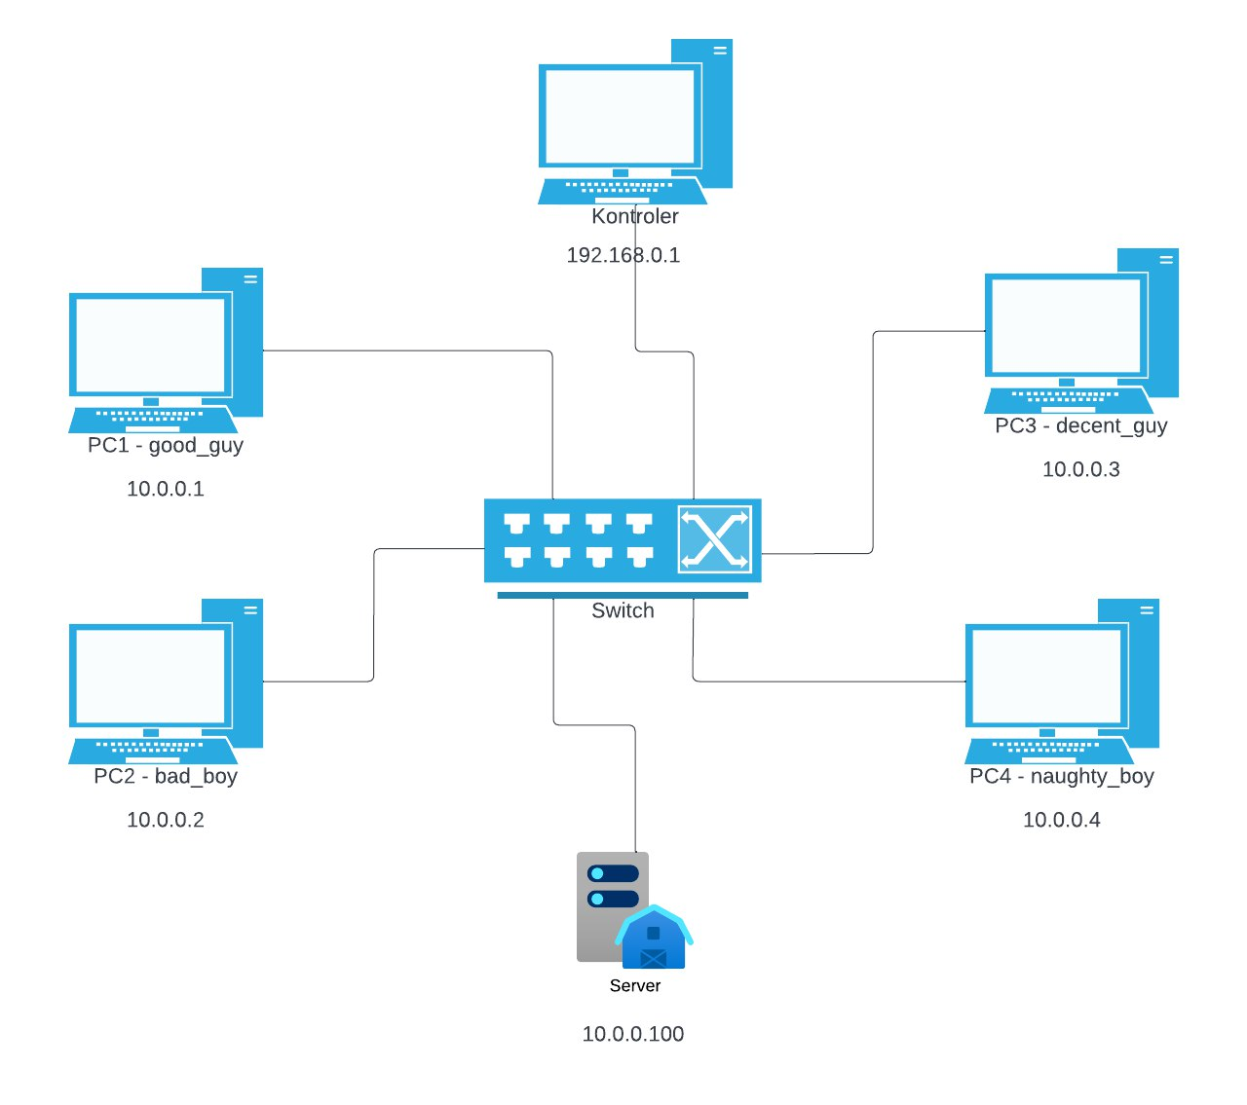
Topology

Slide 5
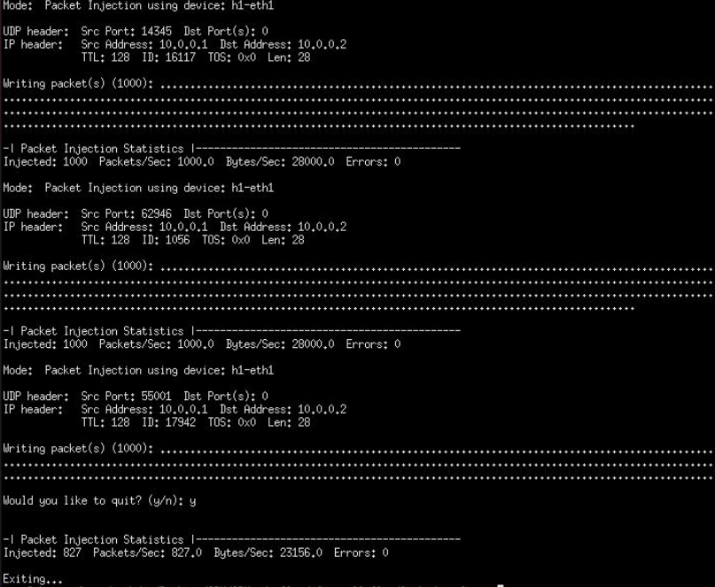
Generator ruchu- packit

Slide 6
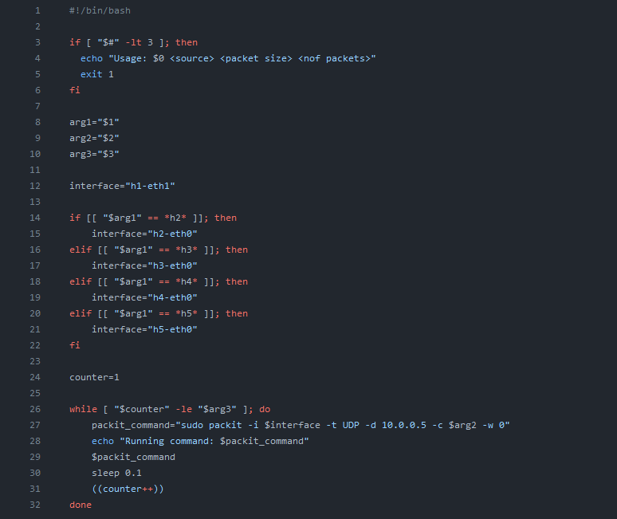
Uruchamiający skrypt

Slide 7
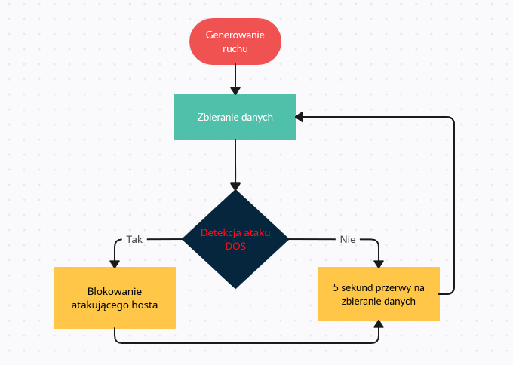
Algorytm

Slide 8
Demo prezentacji

